Slide 1

Safeguarding alcohol policies from undue interference:
Lesson from Sri Lanka
Sampath De Seram – Director Finance and Admin
Alcohol and Drug Information Center Sri Lanka

Slide 2

The history of the process
1995
In 1995 – The Executive President of the country established the Presidential Task Force on alcohol and tobacco.
1997
In 1997 – The Presidential Task Force submitted the policy proposal to the President
1998–2000
A period of no action
2000
In the year 2000 – The bill was presented to the cabinet.

Slide 3
The history cont…
In October 2000, the political situation was unstable and consequently another election was held.
In the middle of 2001, the bill was submitted to the cabinet for approval but again the parliament was dissolved & the UNP (Opposition) government came into power.
Ratification of the FCTC by Sri Lanka

Slide 4
The history cont…
Re–emergence as "private member’s bill” & being challenged at the supreme court of Sri Lanka in 2005/ 2006
Won the case and supreme court decided that the Bill is OK to approve according to the constitution of Sri Lanka
An amended "BILL” was presented to the parliament by the Hon. Minister of Health
Effective from December 2006

Slide 5
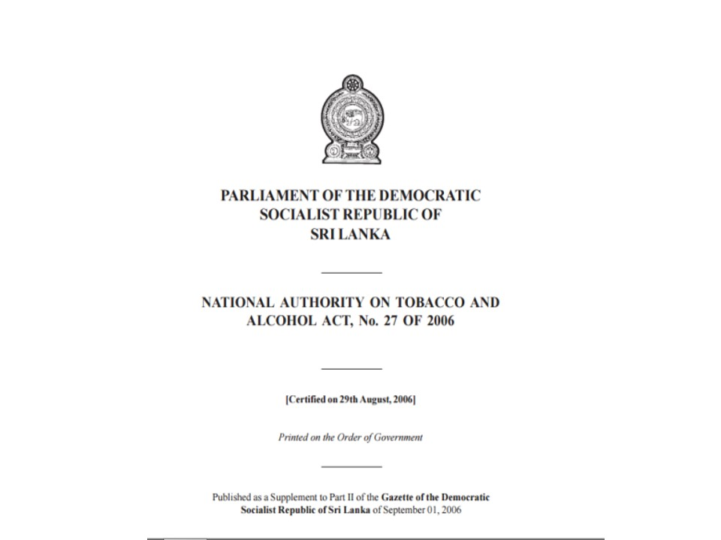

Slide 6
National Authority on Tobacco and Alcohol Act
Definition of Alcohol products - any product containing 1% or more pure alcohol
Purchasing age – over 21 years of age and the seller is liable
Prohibition of vending machines and self-service methods of dispensing alcohol and tobacco products
Prohibition of alcohol and tobacco advertisements
Prohibition of sponsorships for any educational, cultural, social or sporting organization, activity or event by the alcohol and tobacco companies
Prohibition of free distribution of alcohol and tobacco products
Drinking and Driving- Provision relating to motor traffic act
Notes:
Key factors in the act

Slide 7
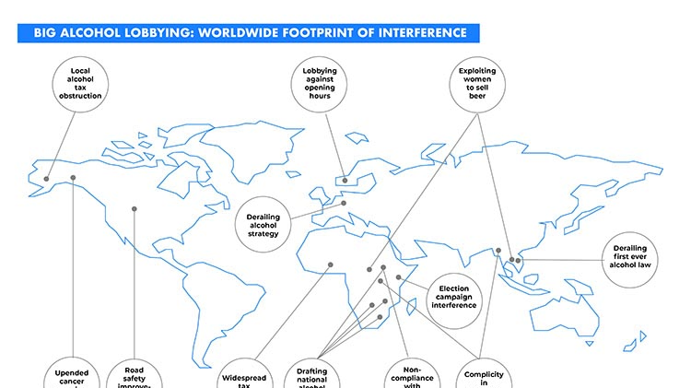
Alcohol industry interference on the process

Slide 8
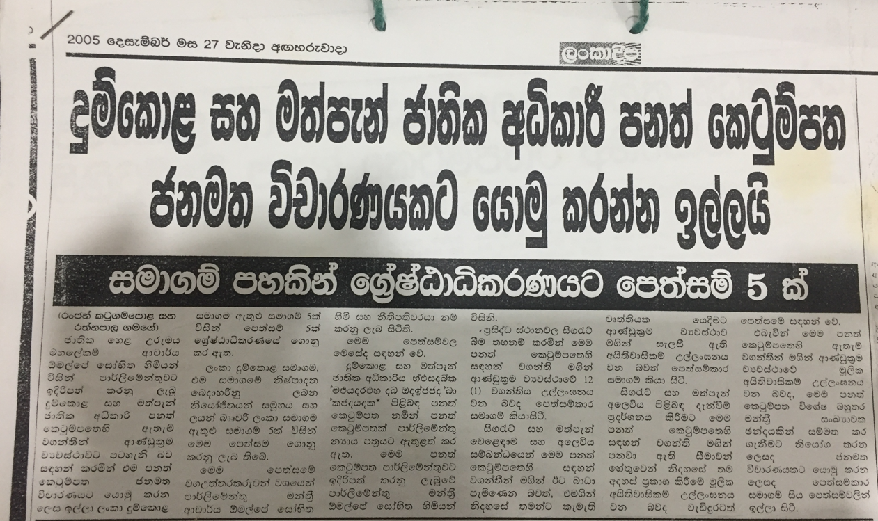
1. Proposed national authority will violate constitute
Translation summary of the paper article
Request for a referendum on NATA act
5 petitions to the Supreme Court of Sri Lanka from 5 companies (CTC & their distribution agents, Lion Brewery Ceylon PLC)

Slide 9
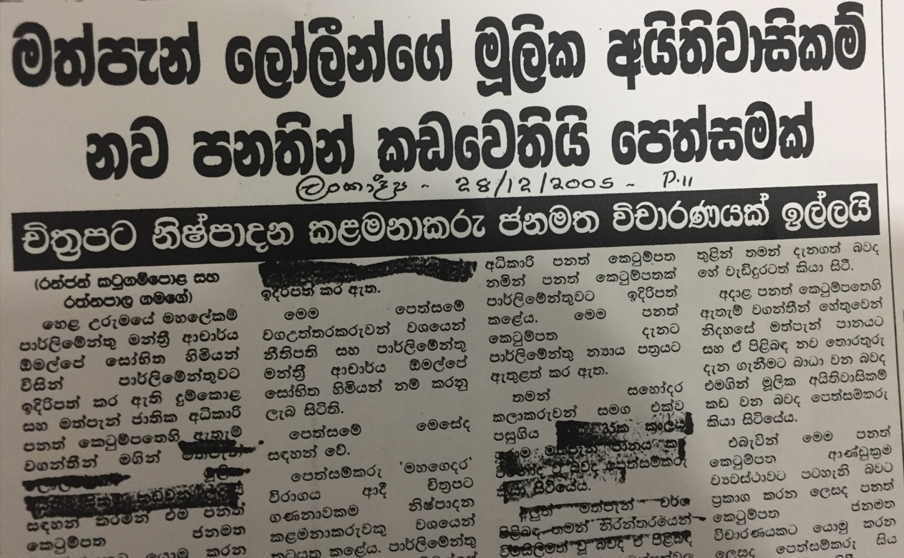
2. It’s consumers right, and it’s violated freedom of choice
Translation summary of the paper article
Proposed act will violate drinkers' rights and freedom
Request for a referendum by the Film Production Manager Union

Slide 10
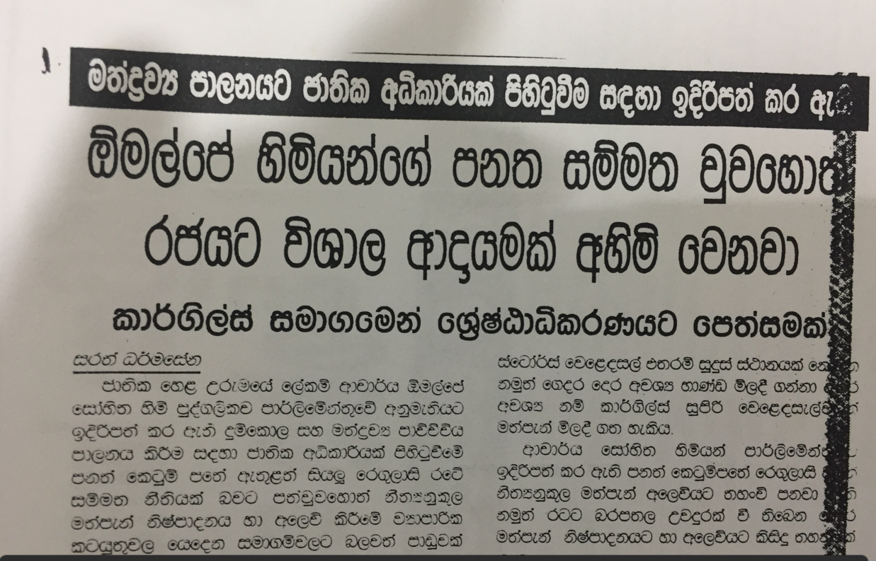
3. Act will ruin the government tax income
Translation summary of the paper article
Proposed national authority will ruin the government income
Petition to the Supreme Court by Cargills (Ceylon) PLC

Slide 11
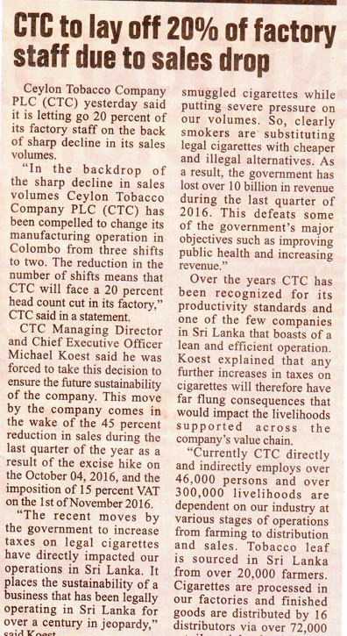
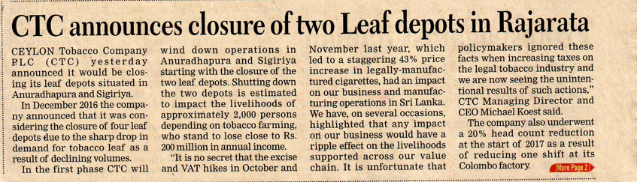
4. Threating government that their employees will lose their jobs

Slide 12
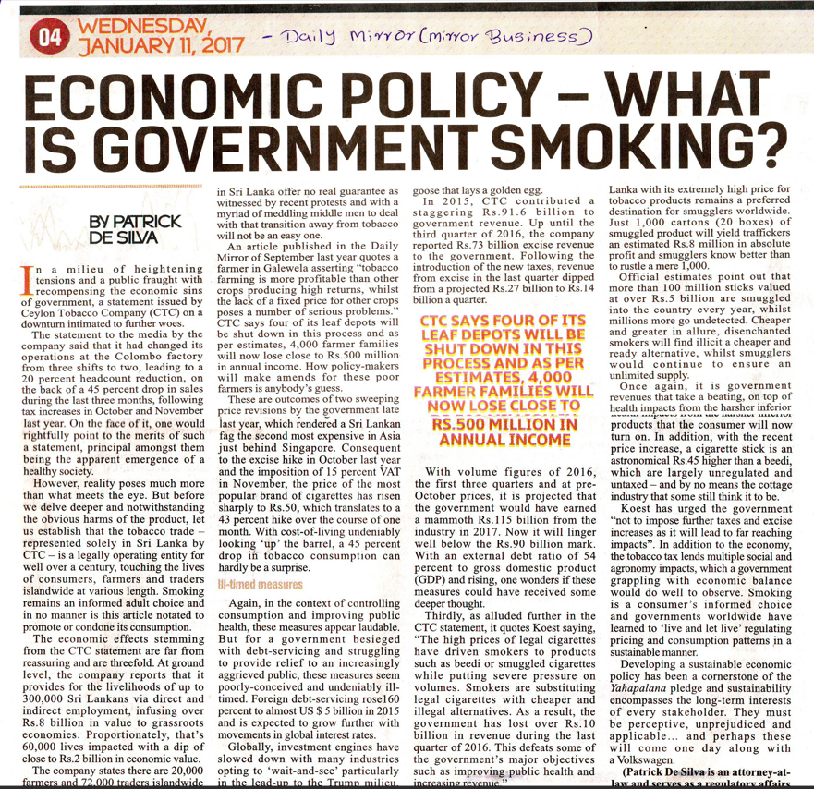
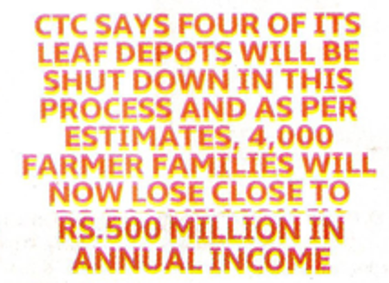
5. Shut down depots

Slide 13
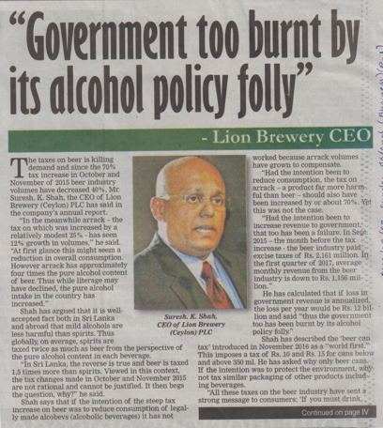
6. Tourism Industry will be affected

Slide 14
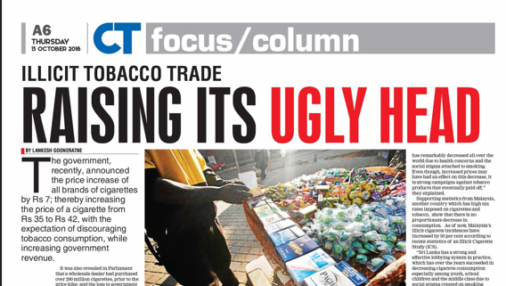
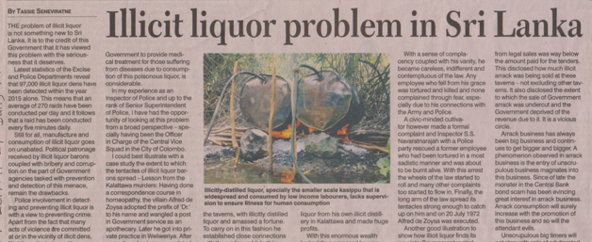
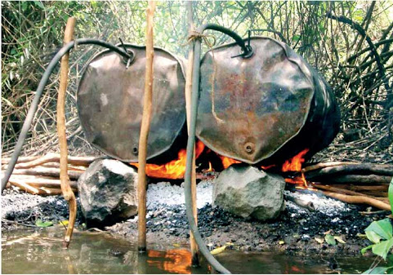
7. Illicit market will rise

Slide 15
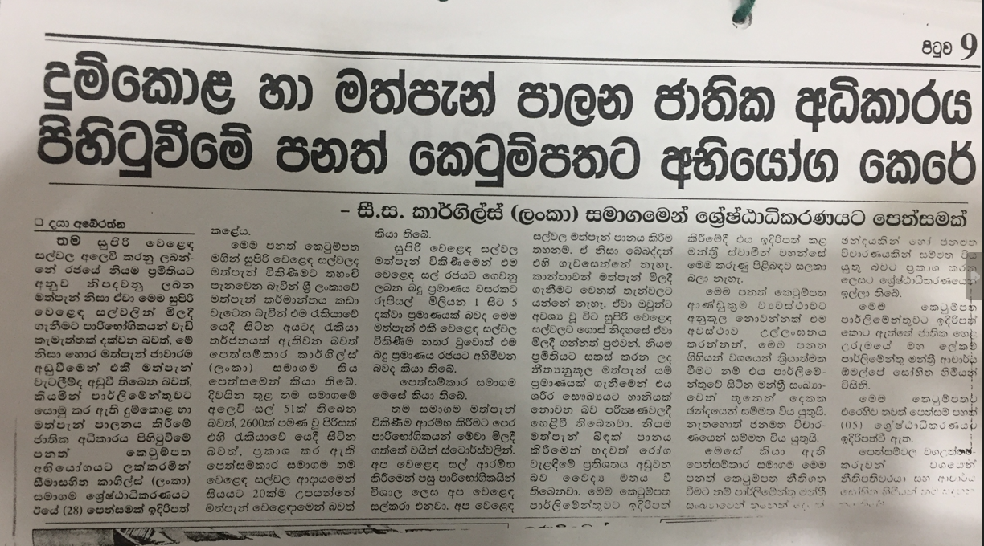
8. Alcohol sellers have license, therefor we don’t need further laws
Translation summary of the paper article
Petition from Cargills (Ceylon) PLC to the Supreme Court – mentioning that they only sell alcohol products manufactured according to the standards. They don’t need further regulation

Slide 16
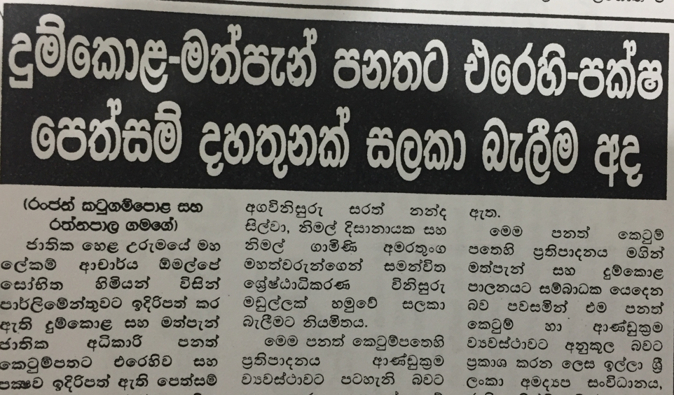
9. Paid front groups challenged the act
Translation summary of the paper article
Consideration of 13 petitions supporting and against the NATA Act by a committee in the Supreme Court

Slide 17
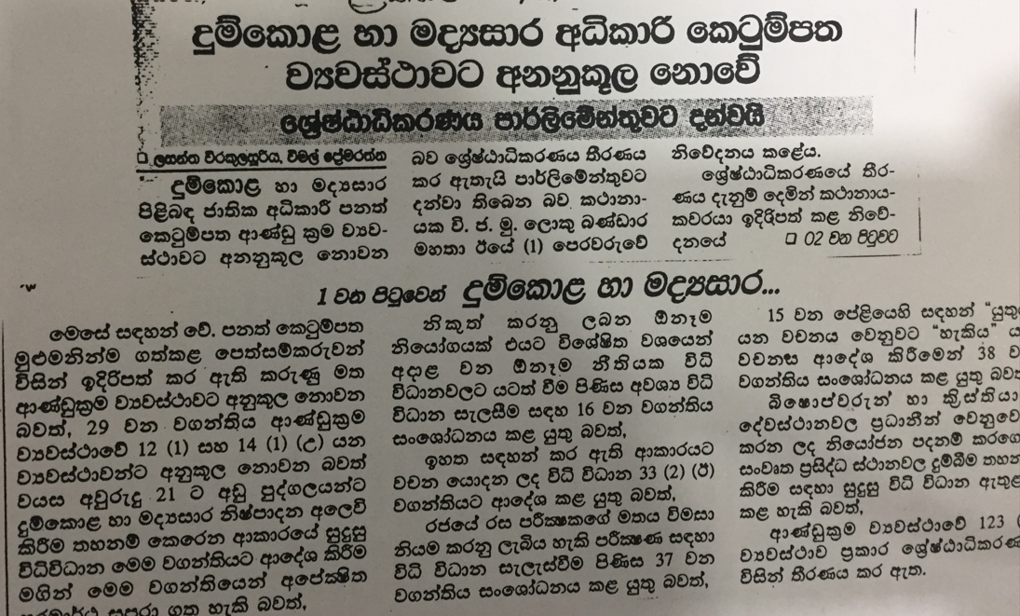
10. Paid media mislead the public
Translation summary of the paper article
The Supreme Court has come to the decision that the NATA act is against the constitution of Sri Lanka

Slide 18
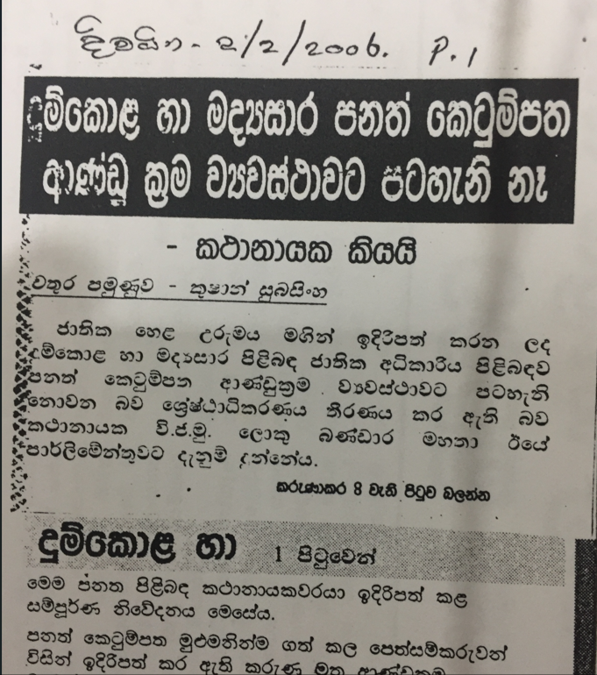
But this is the truth
Translation:
The Supreme Court has decided that the NATA act is not against the constitution of Sri Lanka

Slide 19
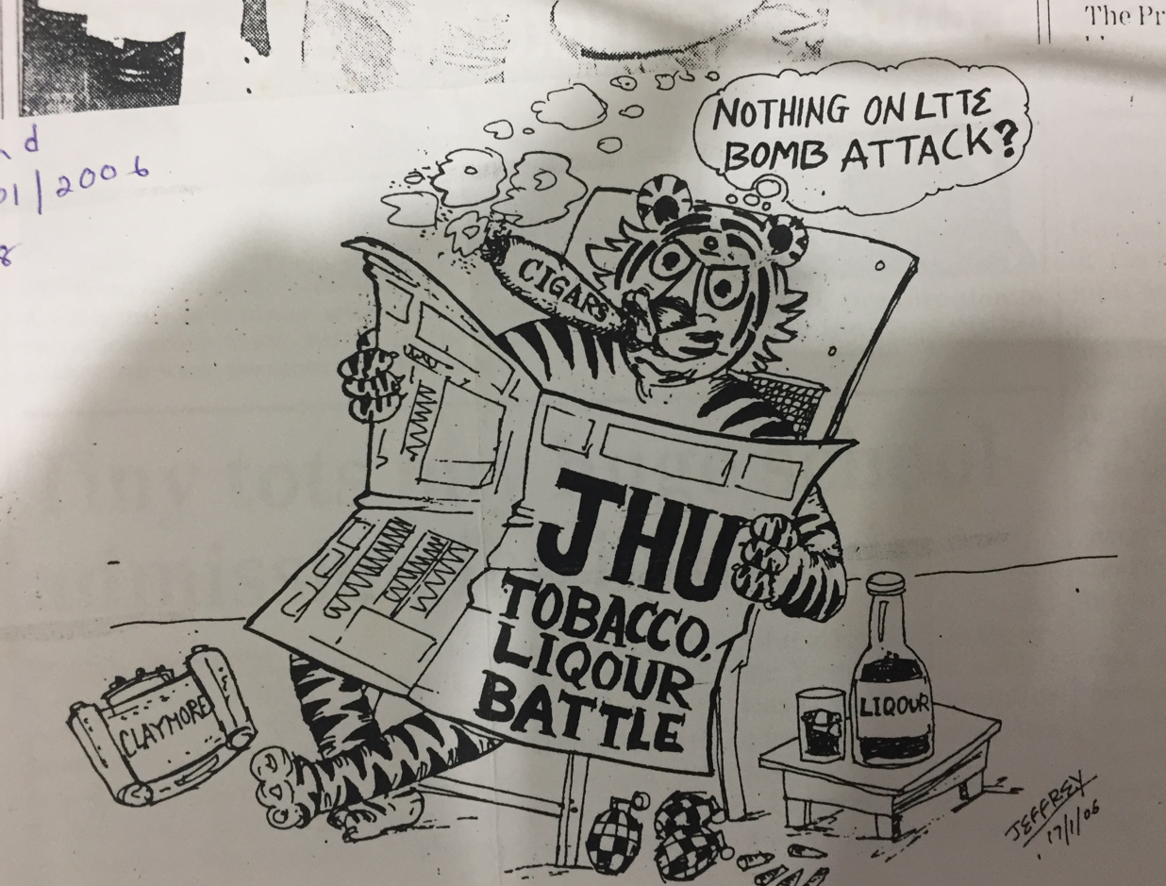
10. Making fun out of the proposed national authority

Slide 20
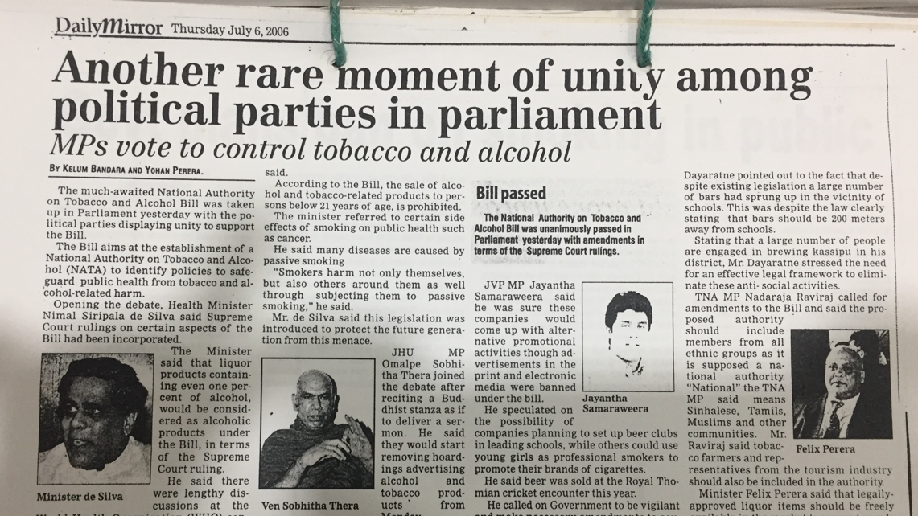
Finally

Slide 21
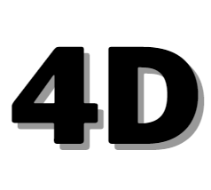
The main tactics the alcohol industry uses to interfere in alcohol policy development
Delay
Derailed
Divide
Destroy

Slide 22
As a summary,
The industry continuously uses various unethical strategies to stop or delay implementation of alcohol control policies.
Aggressive lobbying
Political interference
Creating false debates
Fabricated research regarding alcohol.
Hidden interferences via other front groups
Media,
lawreys,
Film industry,
Tourism industry,
Individual researchers,
Opinion leaders mobilized by the alcohol industry.

Slide 23

After the policy established what was happened ?
Notes:
Now we have a policy; it's good to know how industry interfered after the act is being implemented.

Slide 24
The Battle is not finished
Come-up with self regulation
Providing legal support
Giving training for authorized persons
Funding for politicians and political parties
Create think-tank's and research groups and false research
Giving gift for media personals and academics
Indirect Promotions

Slide 25
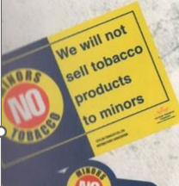
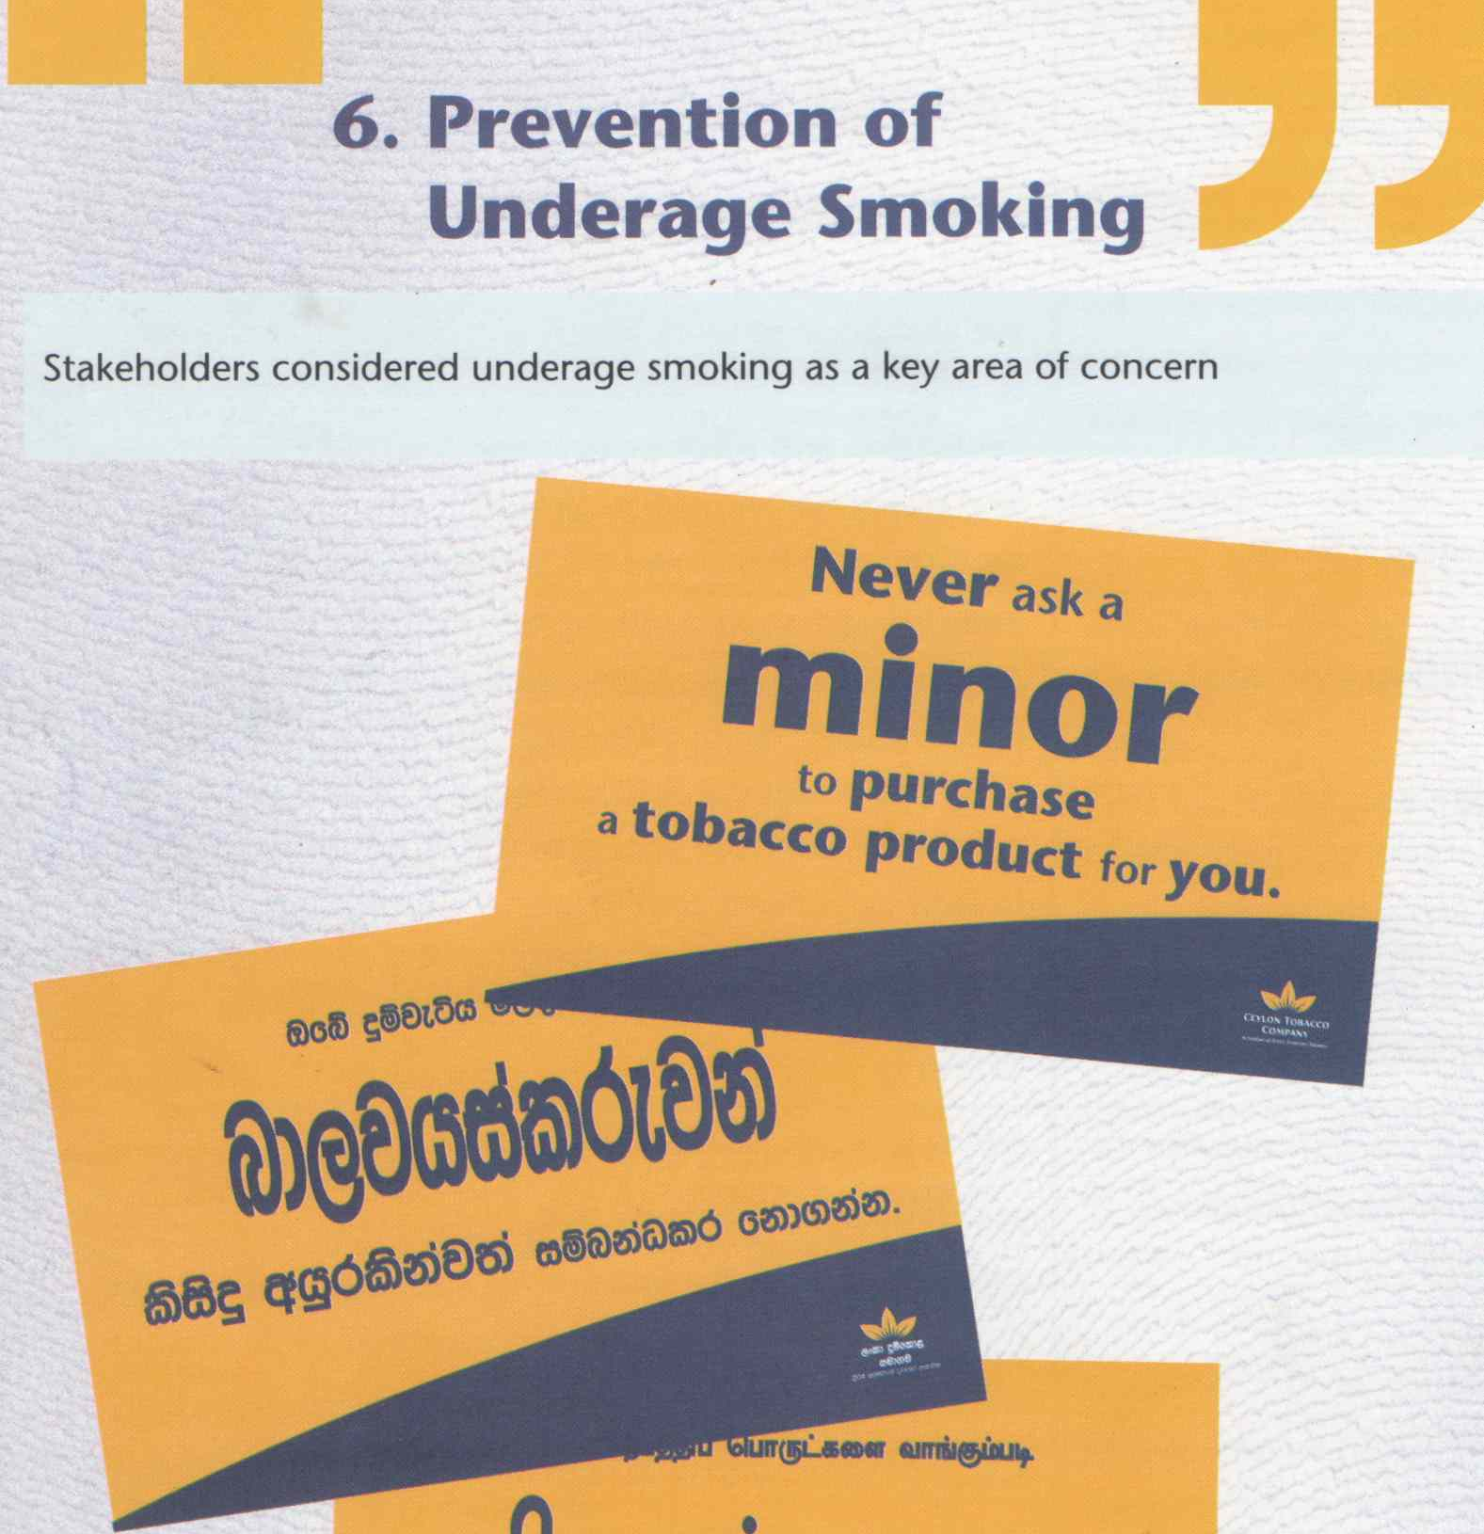
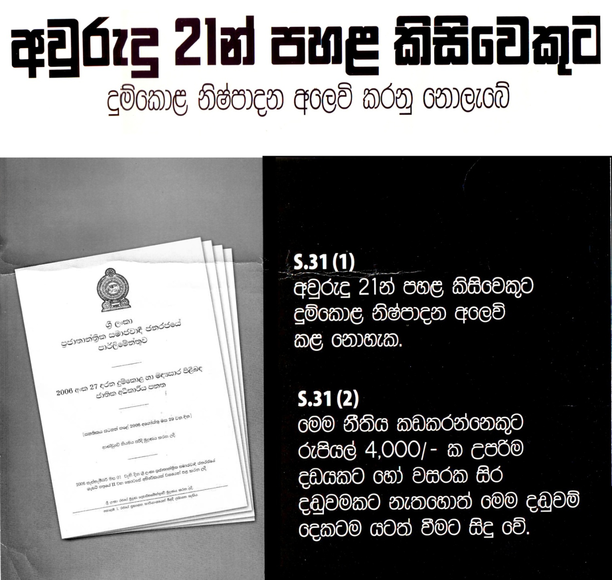
Introduce self regulation

Slide 26
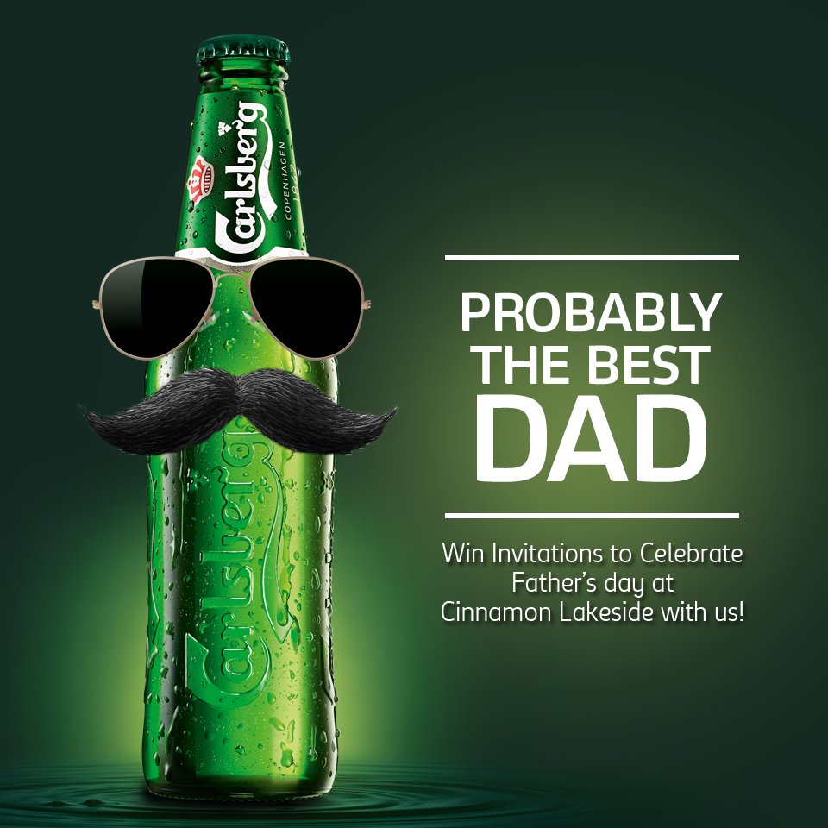
Industry comes with subtle ways to promote their products

Slide 27
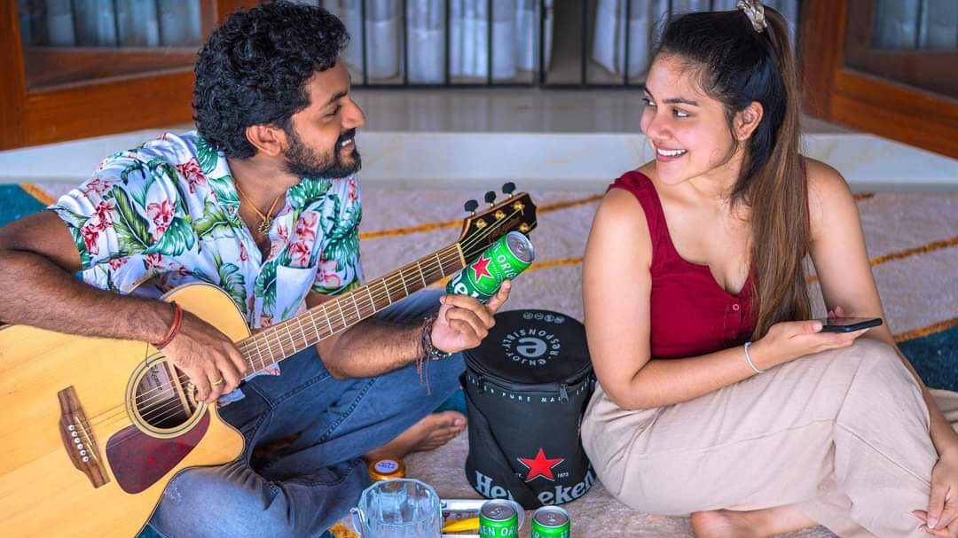
Social media

Slide 28
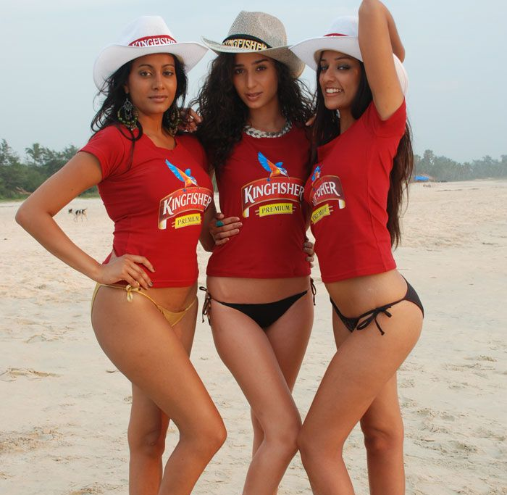
Social Media

Slide 29
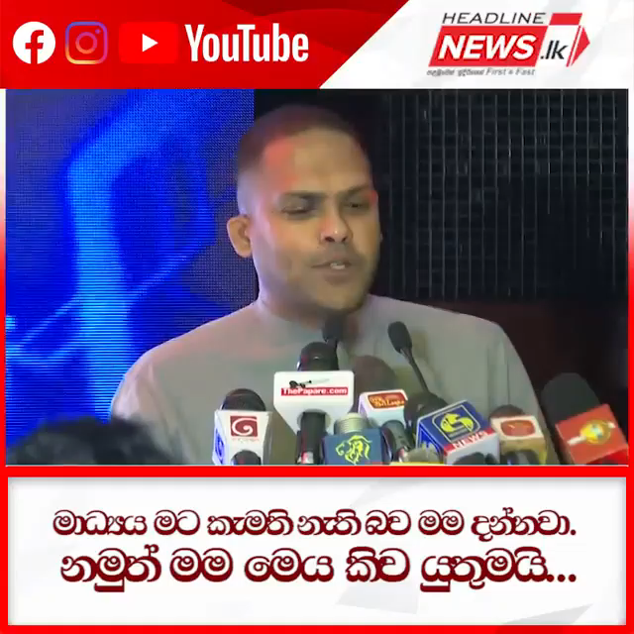
Minister of Tourism of Sri Lanka

Slide 30
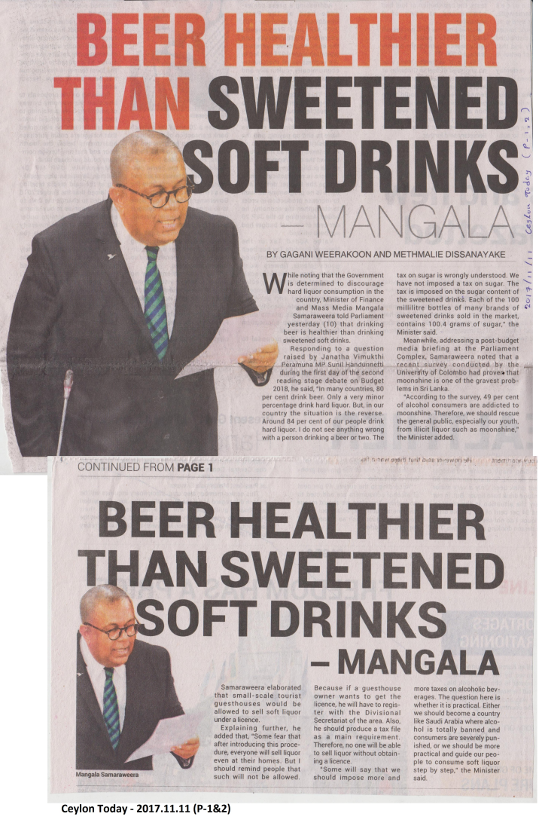
Finance minister Talk behalf of them

Slide 31
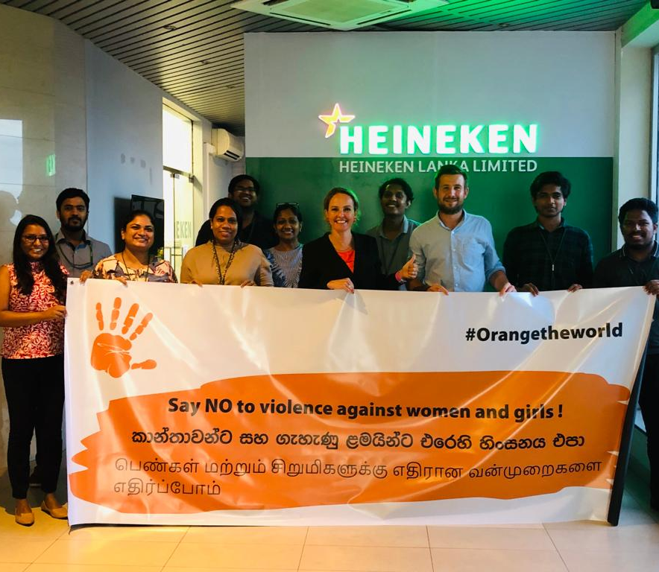
Embassy came with women rights

Slide 32

What should we do ?
Understand that industry interferences occur on every occasion, especially during policy formulation and implementation.
To identify and counter-attack such undue interferences, communities should be act as watch dogs and vigilant about the alcohol industry activities.
The involvement of academics and professionals engage with policy formulation and implementation is very important.
Continuous lobbying of political parties is crucial in effective formulation and implementation of alcohol control policies
Social media and proper media should be continuously utilized to informed general public regarding the importance of alcohol control policies.
Obtaining active involvement of civil society, academics, professionals, policy makers and politicians involved in different capacities.

Slide 33
Thank you

